Slide 1
Теория Информации
В.Н. Ярмолик
Лекция 22
2016

Slide 2
Steganography Hiding in images
Basically, any type of hidden message can be hidden in an image; text, or audio. A basic outline of the steganography process is
1. Identification of redundant bits in a cover medium. Redundant bits are those bits that can be modified without degrading the quality of the cover medium.
2. Selection of a subset of the redundant bit to be replaced with data from a secret message. The stego medium is created by replacing the selected redundant bits with message bits.

Slide 3
Steganography Hiding in images
The advancement of computers is creating an incredible ability to use steganography in images and detecting that there is even an secret message is almost impossible. "To a computer, an image is an array of numbers that represent light intensities at various points, or pixels. The pixels make up the image's raster data. An image size of 640 by 480 pixels, utilizing 256 colours (8 bits per pixel) is fairly common. Such as image would contain around 300 Kilobits of data." Digital images are typical stored in either 24-bits or 8-bit per pixel file." Normally 10% of an image can be used until physical distortions can be detected.
There are three common techniques; least significant bit (LSB) insertion, masking and filtering algorithms and transformations. (Sellars, 2001)
The least significant bit insertion method is the most well known steganography technique. It is the easiest to use but the most vulnerable to attacks. If the LSB is applies of each byte of a 24-bit image, three bits can be encoded into each pixel. There are three bytes in each pixel and any changes made to the pixel bits would be unrecognizable to the human eye.

Slide 4
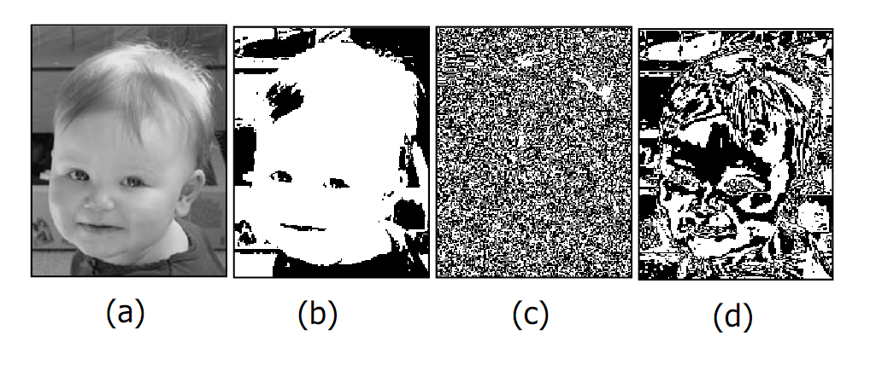
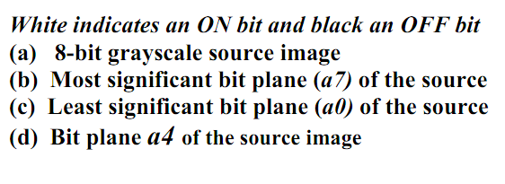
Steganography Hiding in images

Slide 5
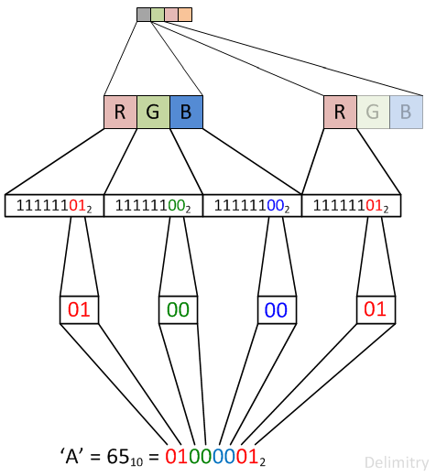
Steganography Hiding in images

Slide 6
Steganography Hiding in images
LSB method - Least Significant Bit Method is very common method in media based steganography to cover the information as least significant bits of media vessel. For graphic media, for example grayscale graphic, when the string of the pixels is represented by bytes
10101010 10001100 11100001 11000011 00010011 01101100 10011001 11111000
The letter ”H” is represented as the binary value of “01001000”. To hide this, the above presented stream would be changed as follows:
10101010 10001101 11100000 11000010 00010011 01101100 10011000 11111000
For RGB format every pixel should be represented by 3 bytes (Red Green Blue) 24 bits. Experiments shows the up to 50% bits have the random nature that is why can be replaced. In this case not only lest significant but up to four last bits, and 1024×768 image can hold up to 1MB of data.

Slide 7
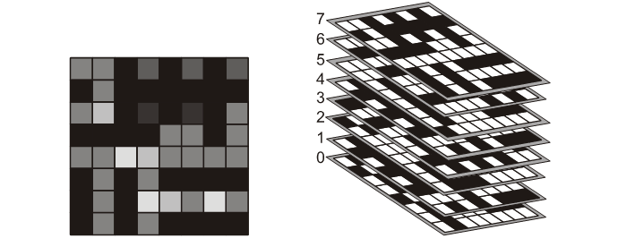
Steganography BPCS Steganography
BPCS Steganography is the Bit Plain Complexity Steganography.
Digital images are categorized as either binary (black-and-white) or multi-valued pictures despite actual color. Then an n-bit image can be decomposed into a set of n binary images by bit-slicing operation.

Slide 8
Steganography BPCS Steganography
The most stegonagraphy techniques,as well as BPCS are based on the category of the region (local area) of the image. Usually the size of the region equals to 8×8 binary patterns are belonging to some 8×8 pixels of the image. There are continuance and random region.
BPCS is based on the 8×8 continuance binary patterns.
The BPCS method makes use of the more complex regions of an image to embed data. Within this method the black-and-white border image complexity have been adopted. The length of the black-and-white border in a binary image is a good measure for image complexity. If the border is long, the image is complex, otherwise it is simple. The total length of the black-and-white border equals to the summation of the number of color-changes along the row and columns in an image. For example, a single black pixel surrounded by white background pixels has the boarder length of 4.

Slide 9
Steganography BPCS Steganography
The image complexity α is defines as:
α = (Real number changes)/(The max. possible Black and White changes in the image)
= k/(2×2^{n}×(2^{n}-1))
0≤α≤1
We assume the image frame is always square having 2^{n}×2^{n} pixels (Practical image size n=2÷12). This characteristic is calculated over the whole image area. It gives us the global complexity of a binary images. However, we can use α for the region or the image block with 8×8 pixels. or bits for our algorithm.

Slide 10
Steganography BPCS Steganography
W
B
B-W
α=0/24=0
α=0/24=0
α=24/24=1
W-B
P
P
α=24/24=1
α=8/24=1/3
α=12/24=1/2

Slide 11
Steganography BPCS Steganography
Conjugation of binary image
We regard black an white pixels have logical value “1” and “0”. Now we define P* as the conjugate of P which satisfies: P*=P⊕(W-B); (P*)*=P; P*≠P where ⊕ means Exclusive OR operation
P
W-B
P*
⊕
=
The most important property about conjugation is the following:
Let α(P) be the complexity of a given image P, then we have
α(P*)=1-α(P)

Slide 12
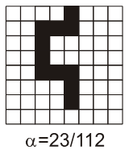
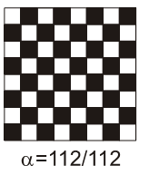
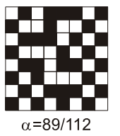
Steganography BPCS Steganography
⊕
=
⊕
=

Slide 13
Steganography BPCS Steganography
Criterion to segment a bit-plane into informative and noise-like regions
First proposition is the size 8×8 bits is a good size for local area. Secondly, our next question is how much image data we can discard without deteriorating image quality, or how small informative data are indispensable to keep image information. To discard data means to replace local image areas in a bit-plane with random noise patterns. If we replace all the local areas having complexity value α_{L}≤α , yet it still maintains a good quality, then we can discard more. If it is not more a good quality, we can not discard that much. If α=α_{L} is the minimum complexity value to be good, such α_{L} is the threshold value. To be “informative” for the image means the following. If the image data is still “picture-like” after we have discarded (randomized) certain amount of image data for such an α_{L} and if we discard more, then it becomes only “noise-like”. Then, that α_{L} is regarded as the limit of the informative image complexity.

Slide 14
Steganography BPCS Steganography
There are 99,999999999999333% noise-like patterns among of all 8×8 binary patterns for α_{L}=0.3.
Surprising enough, it is only 6,67×10⁻¹⁴% informative patterns
BPCS Steganography Algorithm
The vessel is a color image in BMP format, which hides (or, embeds) the secret information (file in any format). Secret file is segmented into a series of blocks having 8 bytes of data each. These block (secrete blocks) are regarded as 8×8 image patterns.
1.Transform the vessel image from PBC to CGC system. 2.Segment each bit-plane of the vessel image into informative and noise-like regions by using a threshold value α_{L} A typical value is α_{L}=0.3.

Slide 15
Steganography BPCS Steganography
3.Group the bytes of the secrete file into a series of secrete blocks S.
4.If a block S is less complex than the threshold α_{L} , then conjugate it to make it a more complex block S*. The conjugated block must be more complex due to α(S*)=1-α(S).
5.Embed each secret block into the noise-like regions of the bit-planes (or, replace all the noise-like regions with a series of secret blocks). If the block is conjugated, then record this fact in a “conjugation map”. 6.Also embed the conjugation map as was done with the secret blocks.
7.Convert the embedded vessel image from CGC back to PBC.
The decoding algorithm is just the reverse procedure of the embedding steps.

Slide 16
Steganography BPCS Steganography
Embedding Capacity:
The numerous experiments show that most color images taken by digital camera can used as vessel images. In almost all cases, the information hiding capacity was nearly 50% of the size of each vessel image. Next table shows the capacity changes with threshold for the digital image of the authors of the BPCS Steganography.
Threshold α | Capacity Bytes | Percent of original %
20/64 | 499432 | 44
25/64 | 469480 | 41
30/64 | 437240 | 38
35/64 | 400848 | 35
40/64 | 361800 | 32
45/64 | 315432 | 27

Slide 17
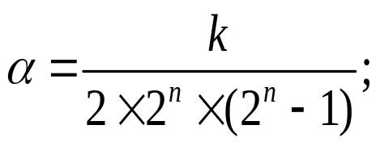
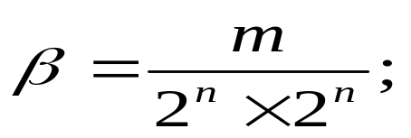
Steganography BPCS Steganography
There are two metrics for image complexity estimation within
the BPCS Seganography. The first one α based on the weighted length
k of the B-W border within the image block.
The second one β represents the weighted number m of the regions within the block with black or white color.

Slide 18
Steganography BPCS Steganography
W: α =0, β=0,015625 B: α=0, β=0,015625
W_{C}: α=β =1 B_{C}: α=β =1

Slide 19
Steganography BPCS Steganography
α=50/112, β=2/64 α=49/112, β=2/64

Slide 20
Steganography ABCDE Steganography
ABCDE Stegangraphy – A Block Complexity based Data Embedding can be regarded as an extension of BPCS steganography as based on three measures of complexity: black-and-white border complexity measure (the same as for BPCS); run-length irregularity; border noisiness.
For the example of chessboard pattern (B-W) the measure α=1, i.e. the maximum of α. This block, however, has a regular periodical pattern, and cannot be regarded as complex one.
B-W
W-B-L
A possible workaround here is to introduce a upper limit threshold α_{U} and to accept only blocks those have α belongs to interval α_{L}≤α≤α_{U}. Unfortunately, even if we adopted this new criterion, we may still encounter blocks like W-B-L, for which α=0.5

Slide 21

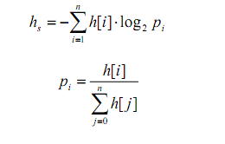
Steganography ABCDE Steganography
Run-Length Irregularity – is defined based on the histogram of the run-lengths of both black and white pixels along a row or a column. Suppose that we have a binary pixel shown below
It consists of: a run of one black pixels; a run of two white pixels; a run of two black pixels and a run of three white pixels. Here we find that h[1]=1, h[2]=2, h[3]=1, Where h[i] is the frequency of runs of i pixels in black or white.
The following h_{s} is now introduced to measure the irregularity of a binary pixel sequence:
where n is the longest run-length possible

Slide 22
Steganography ABCDE Steganography
For the W-B region we have eight of one white and and eight of one black runs, so h[1]=16, and there are not any runs with more pixels. That is why p₁=16/16=1, and h_{s}=0.
For the W-B-L region we have two of four white and and two of four black runs, so h[4]=4, and there are not any runs with more pixels. That is why p₄=4/4=1, and h_{s}=0.
If a sequence contains runs of the same length only, it would reveal a regular periodicity. On other hand, if a sequence contains runs of various lengths, it would not have any distinct periodicity, and h_{s} would become large.

Slide 23
Steganography ABCDE Steganography
The border noisiness complexity measure is computed based on the differences between adjacent binary pixel sequences in a block. Let the block size be n×n (n>1). Let r_{i} and c_{j} be i-th row and j-th column of a block respectively. The border noisiness γ of a block is defined as follows:
γ=min{E_{f}(P_{x}(r)),E_{f}(P_{x}(c))}/(n-1)
Where P_{x}(r)={g(r₀⊕r₁),...,g(r_{n-2}⊕r_{n-1})}; P_{x}(c)={g(c₀⊕c₁),...,g(c_{n-2}⊕c_{n-1})}, symbol ⊕ denotes bit wise exclusive-or, g(x) is the number of ones in a binary sequence x, and
E_{f}(X)= (1.0-Var(X)/max_{X}{Var(X)})Aver(X)
X={x₀,...x_{m-1}}; Var(X) is the variance of X; and Aver(X) is average of X.
The definition of the border noisiness γ is similar to that of the run-length irregularity β. The number of the black-and-white pixel borders are counted for every pairs of adjacent rows and columns. They are represented by the set P_{x}(r) for rows and P_{x}(c) for columns in the above definition. A weighted average E_{f} is then computed against these sets.

Slide 24
Steganography
Run-length mechanism
A run-length mechanism for hiding data into binary images is based on the concept of visibility; i.e., the edge portion of host binary images is used for hiding secure data, because the modification of edge portion is more difficult to be recognized by human eyes. To embed a single bit, for example “1”, of secure data, we let the running length be odd, and vice versa.
Embedded Procedure
First of all the binary vessel image is represented by a bit stream using the raster scanning order. Let O denote this image, O={o_{i}|o_{i}∈{0,1}, i=1,2,...,H×W} where H and W denote the height and width of the host image, respectively. The data to be embedded into the host image is also represented by a bit stream D ={d_{i}|d_{i}∈{0,1}, i=1,2,...,L}, where L denotes the length (in bit) of D, and its value is depended on O and quality control parameter. Next, we examine o_{i}, for i=1,2,...,H×W, and count the length (called run-length) of the continued pixels with the same bit value. When a pixel’s value has varied, a run-length r_{j} is obtained.

Slide 25
Steganography
Run-length mechanism
And each run-length will embed a bit d_{j}, where j=1,2,...,L. We illustrate the definition of run-length by the following:
O
1
1
1
1
1
1
0
0
0
0
0
1
1
...
r_{j}=7
v_{j}
r_{j+1}
v_{j+1}
If d_{j}≠r_{j} mod 2, the pixel v_{j}’s value should be changed, i.e., the value of r_{j} will increase one. Otherwise, there is no pixel required to change for embedding d_{j}

